Slide 1
What we have to do

Slide 2
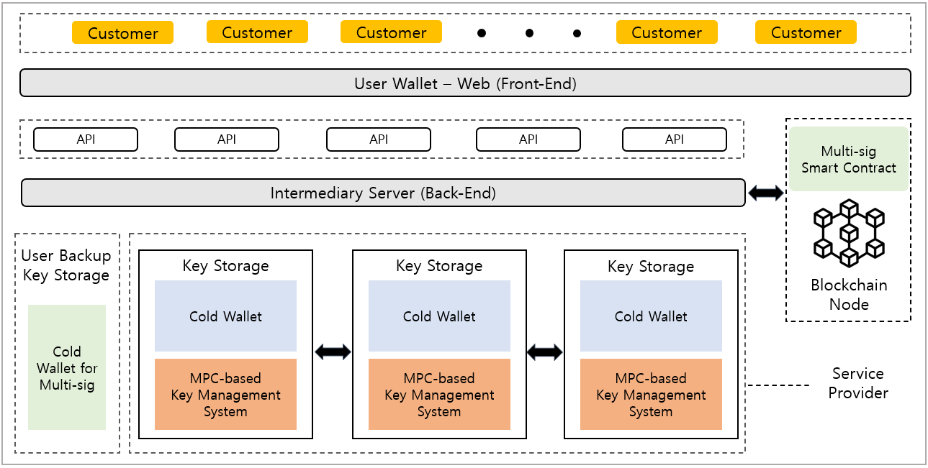



Implementation
User interface
2-of-3 multi-sig (Open Source) (https://github.com/BitGo/eth-multisig-v4)
Ethereum private network
Node.js for API server
Geth (Go-Ethereum) for Ethereum client
(https://github.com/ethereum/go-Ethereum)
Server
Multi-party ECDSA protocol (Open Source)
Lindell17 (2-party ECDSA)¹
GG18 (ECDSA Threshold)²
GG20 (One round ECDSA Threshold)³
[1] Lindell, Y.: Fast secure two-party ecdsa signing. In: Annual International Cryptology Conference. pp. 613–644. Springer (2017)
[2] Gennaro, R., Goldfeder, S.: Fast multiparty threshold ecdsa with fast trustless setup. In: Proceedings of the 2018 ACM SIGSAC Conference on Computer and Communications Security. pp. 1179–1194. ACM (2018)
[3] Gennaro, R., Goldfeder, S.: One round threshold ecdsa with identifiable abort. Cryptology ePrint Archive, Report 2020/540 (2020)

Slide 3
Have to Implement
User wallet
Back-end server – for user wallet and MPC (working)
MPC – On process
Multi-sig smart contract
I think we can more develop the wallet which we have implement at Assignment 9.
I will make github project as soon as possible.

Slide 4
User wallet
I think User wallet, backend server, multi-sig smart contract is related.
There are some functions of wallet
Create account – related with multisig(server will call contract)
Send transaction – related with multisig
Check balance – related with backend (web3.js)
Check history of transaction – related with backend (web3.js)
To implement
Design of user wallet (react, html …)
Connection with backend server

Slide 5
Backend server
Using web3.js
Contact with user wallet
Call the multi-sig smart contract
MPC server
This is for MPC Key management system
I will make it with MPC.

Slide 6
Multi signature smart contract
https://github.com/BitGo/eth-multisig-v4
https://github.com/gnosis/MultiSigWallet
https://github.com/ConsenSys-Academy/multisig-wallet-exercise
https://github.com/EthereumCommonwealth/ethereum-classic-multisig
https://github.com/project-serum/multisig

Slide 7
My process
Can generate ECDSA signature using MPC
At using this signature (r,s) in Ethereum transaction signing, there is problem.
I use same key but the “from address” which is interpreted in signed transaction keep changing.
Still doing trouble shooting.

Slide 8
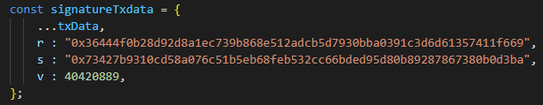
ECDSA public key K = (x,y) in elliptic curve
Ethereum public key translation : “04” | x | y (Standards for Efficient Cryptography (SEC1))
=> “04d604f22b8f063a5091027f4a63937cc0131a2ef369fdfb4d6a129b63af7d507a20efd3231d0eb3aeda4e96162ea4557cec481a050cfb8dc90d9e6633a877787c”
Ethereum address translation from public key
Sign using MPC -> signature (r,s) and v
Create signed transaction and find sender address

Slide 9
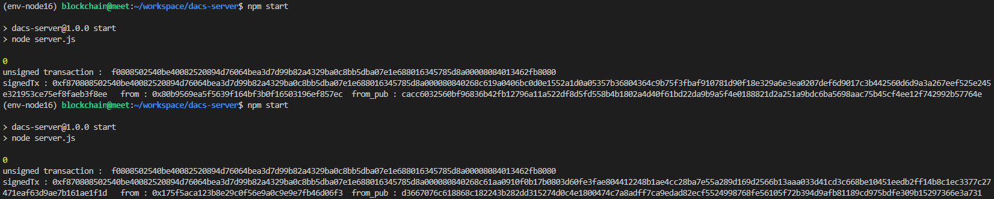
Ethereum says from address is “0xf45b2b9c6455c6dd1cfc968e2b8d1a7a46b66f6a”
But our address created from public key was “0x28b3FCEdBb5168452374eB58F957d62be223381F”
Even the this blue color address keep changing when I sign same unsigned transaction.
So, we can’t send the Ether. I’m still working this trouble shooting.
Problem 2
If I create another signature of same transaction (r, s is different), then the server shows different sender address every time.

Slide 10
So in this week?

